Slide 1


Software Project Management
Sports
Performance
Analysis System
Group 3
TEAM MEMBERS
Duc, Nguyen Nhu Minh 30219263424
Hai, Huynh Thi 30205127541
Ngoc, Tran Thi Bao 30209256289
Suong, Ung Thi Thu 30206959173
Trang, Dinh Thi Thu 30201123797
Instructor: Le Kim Hoang

Slide 2










Reason for Choosing the Topic
Big Data Growth
Automation Need
Intuitive Web UI
Tự động hóa
Trực quan hóa
Sports generate massive data → requiring scalable systems to process millions of records.
Coaches need automated, real-time insights to make quick, accurate decisions.
A web platform gives easy, cross-device access to complex statistics.
Giao diện Web giúp HLV theo dõi thông tin chiến thuật một cách dễ dàng.

Slide 3

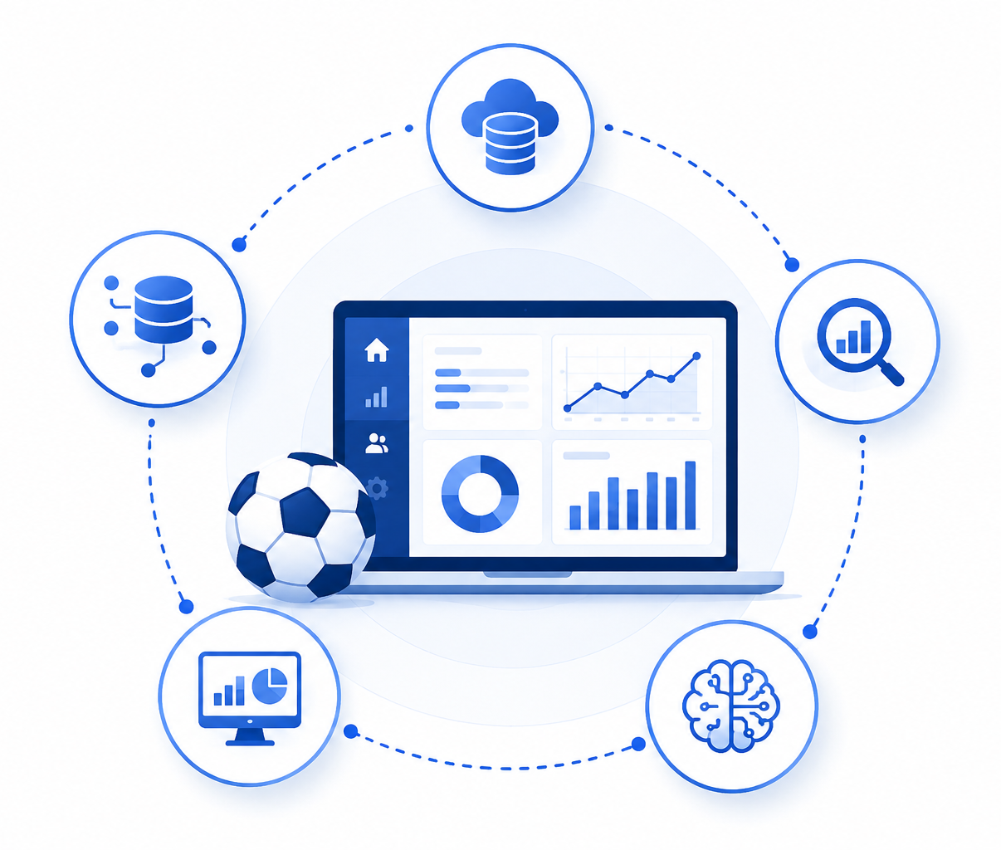
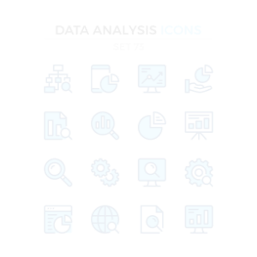
System Objectives
Data Integration: Analyze historical KPIs to evaluate team and player performance.
Deep Analytics: Present insights through dashboards, charts, and intuitive UI.
Prediction Engine: Display real-time trends: goals, form, stats, and team comparison.
Visualization: Support match outcome forecasting using machine learning models.

Slide 4
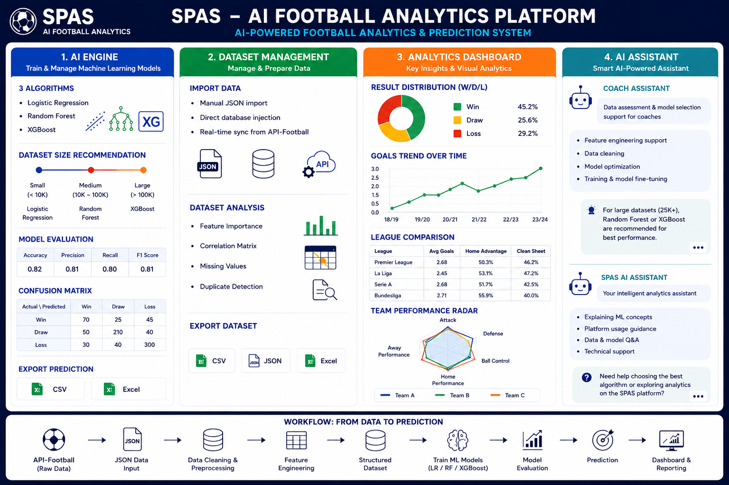

CORE
WEB FEATURES

Slide 5
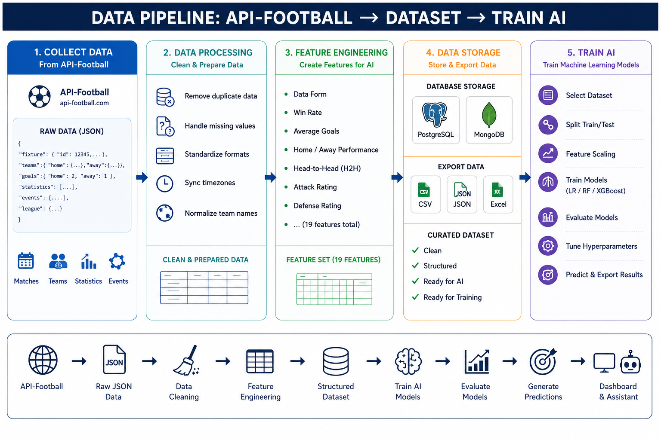

Slide 6

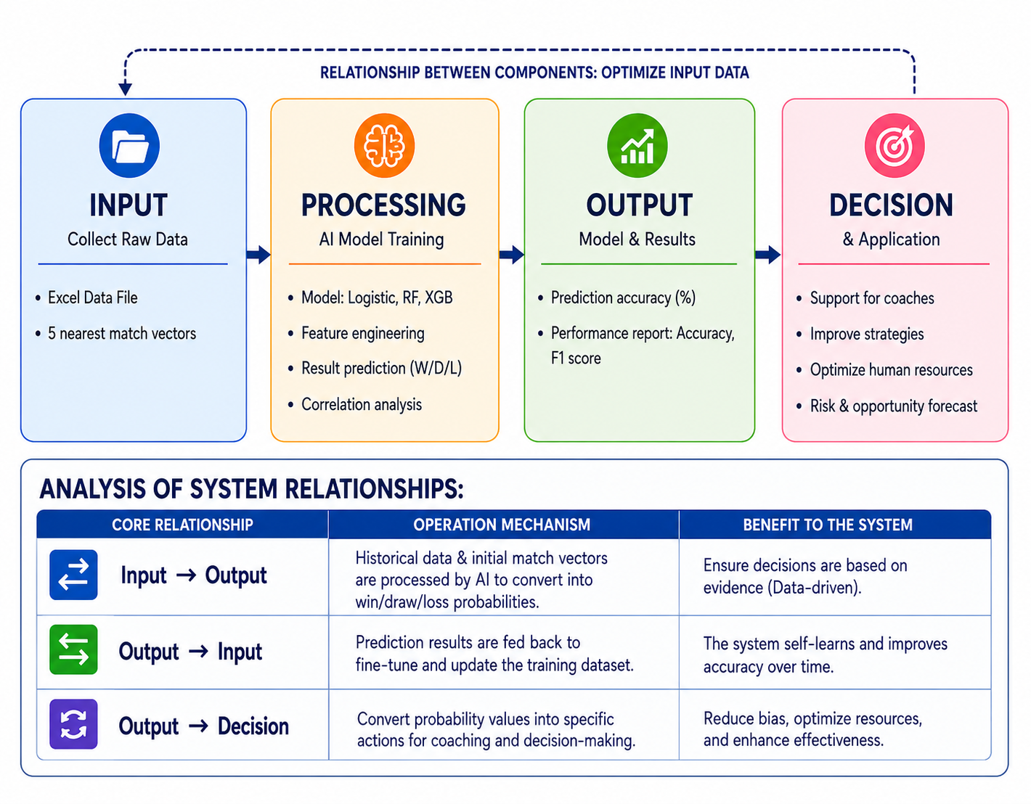
Training the AI Engine
AI LOGIC

Slide 7







Kiến trúc Frontend & Backend
Frontend
Backend

Slide 8
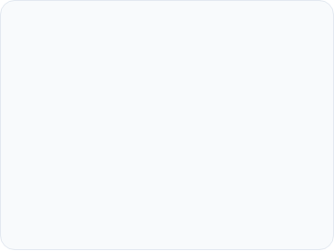

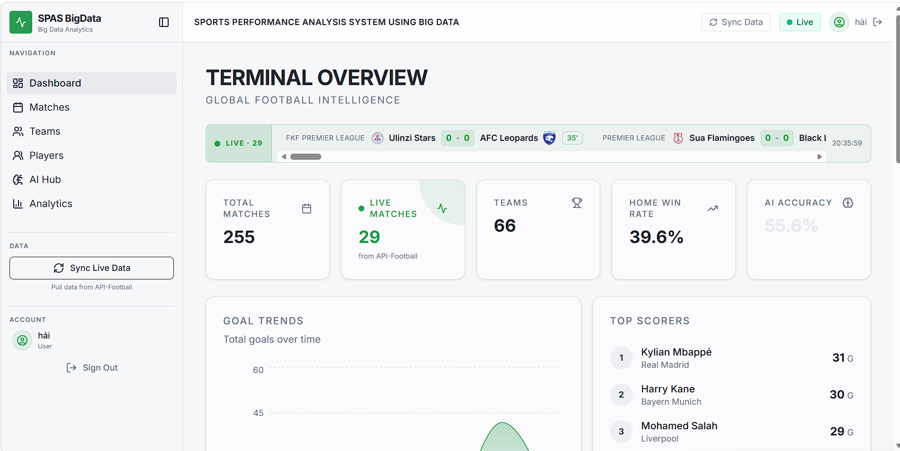


Frontend
Visual Interface (UI/UX)
Interactive dashboard system with real-time charts.
Management Module
Dedicated pages for Matches, Teams, Players, AI Hub, and Analytics.
Data Processing
Call APIs via Axios to receive, process, and display JSON-formatted data streams.

Slide 9
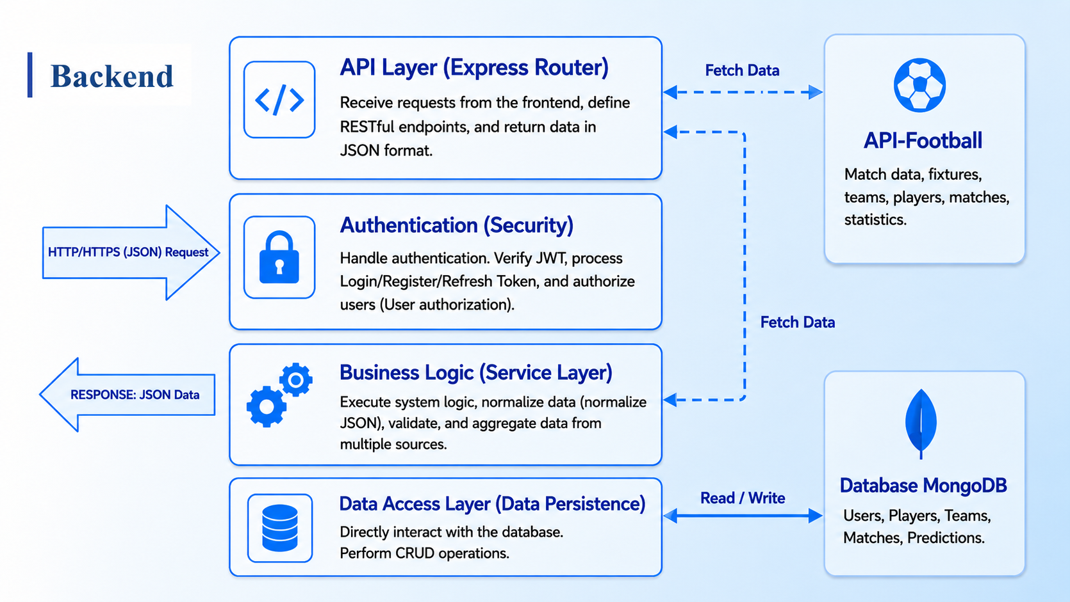

Slide 10
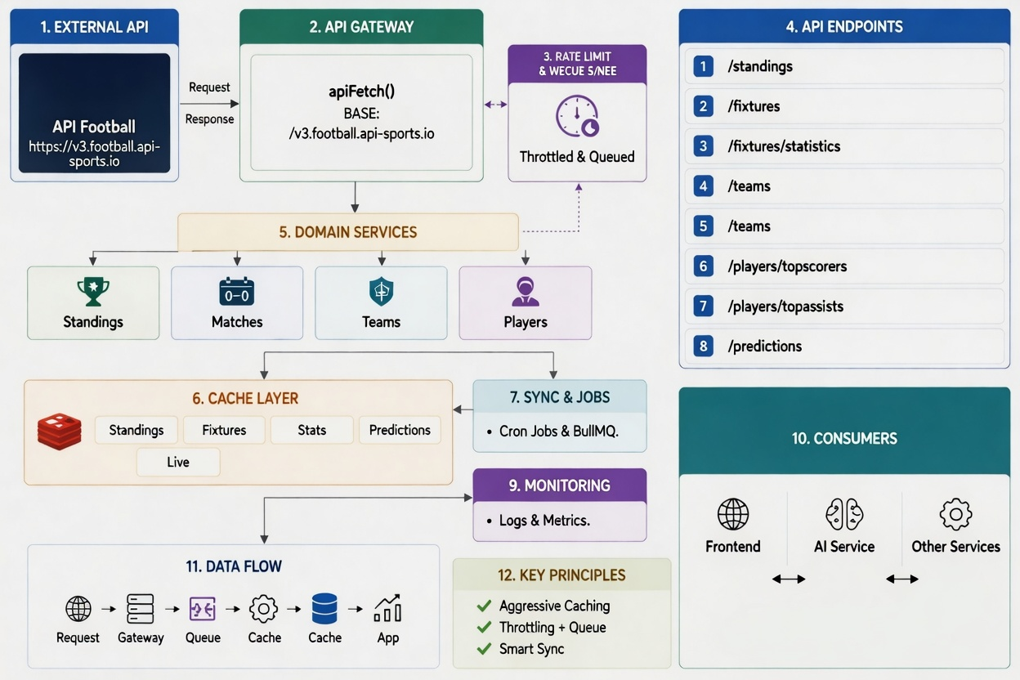
How to use and process APIs retrieved from API-
Football

Slide 11

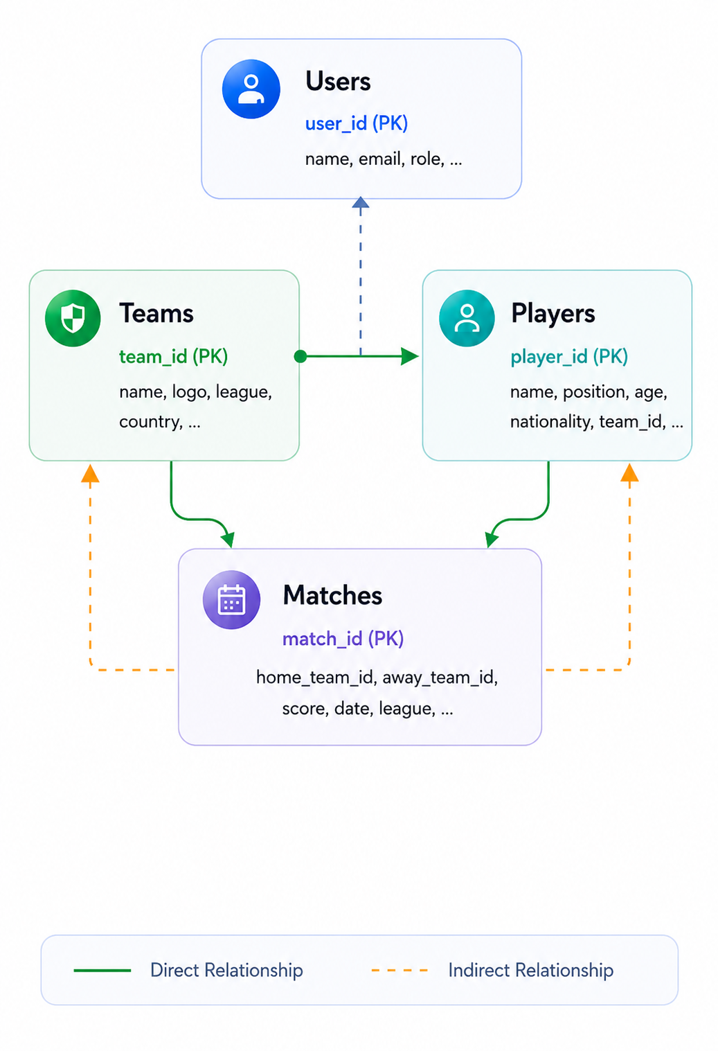
Database Structure (MongoDB)
DATA
Collection | Description
Users | Profiles, credentials, and access roles.
Teams | Clubs, logos, and league rankings.
Players | Personal stats, historical performance.
Matches | Scorelines, schedules, and live events.

Slide 12
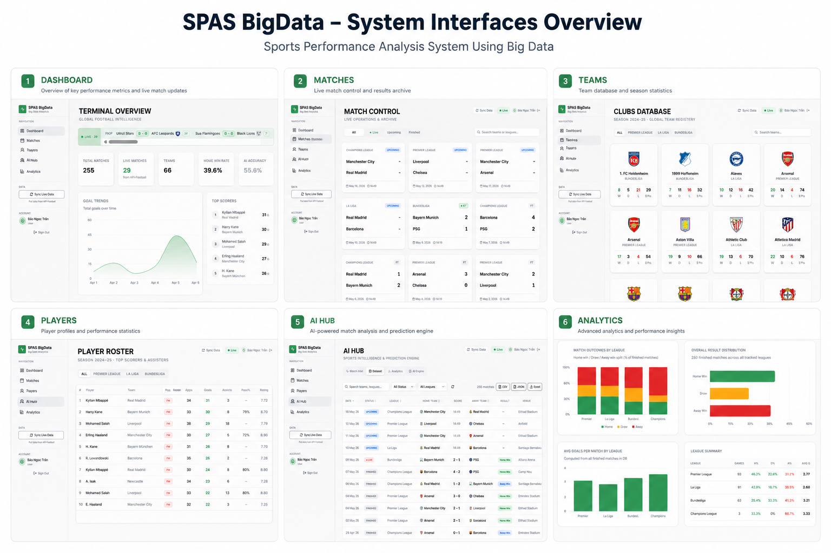
Platform Demo – System Interface Overview

Slide 13

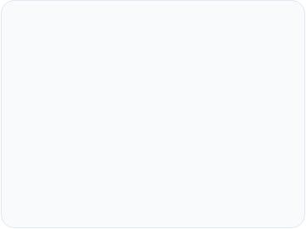




Benefits of the System
Automation
Accuracy
Speed
Dramatically reduces manual workload for data collection and analysis by leveraging seamless API-Football synchronization, freeing coaches to focus on player psychology and leadership.
Big Data-driven insights provide a higher level of precision for tactical planning, player evaluation, and objective performance tracking, removing human bias from decision-making.
Enables faster decision-making with real-time visualized data and instant analysis.
Future Scalability : The separated MERN stack architecture allows for easy expansion to new sports leagues and advanced AI model integration.
Dễ mở rộngKiến trúc hiện đại, sẵn sàng tích hợp các cảm biến IoT mới.

Slide 14

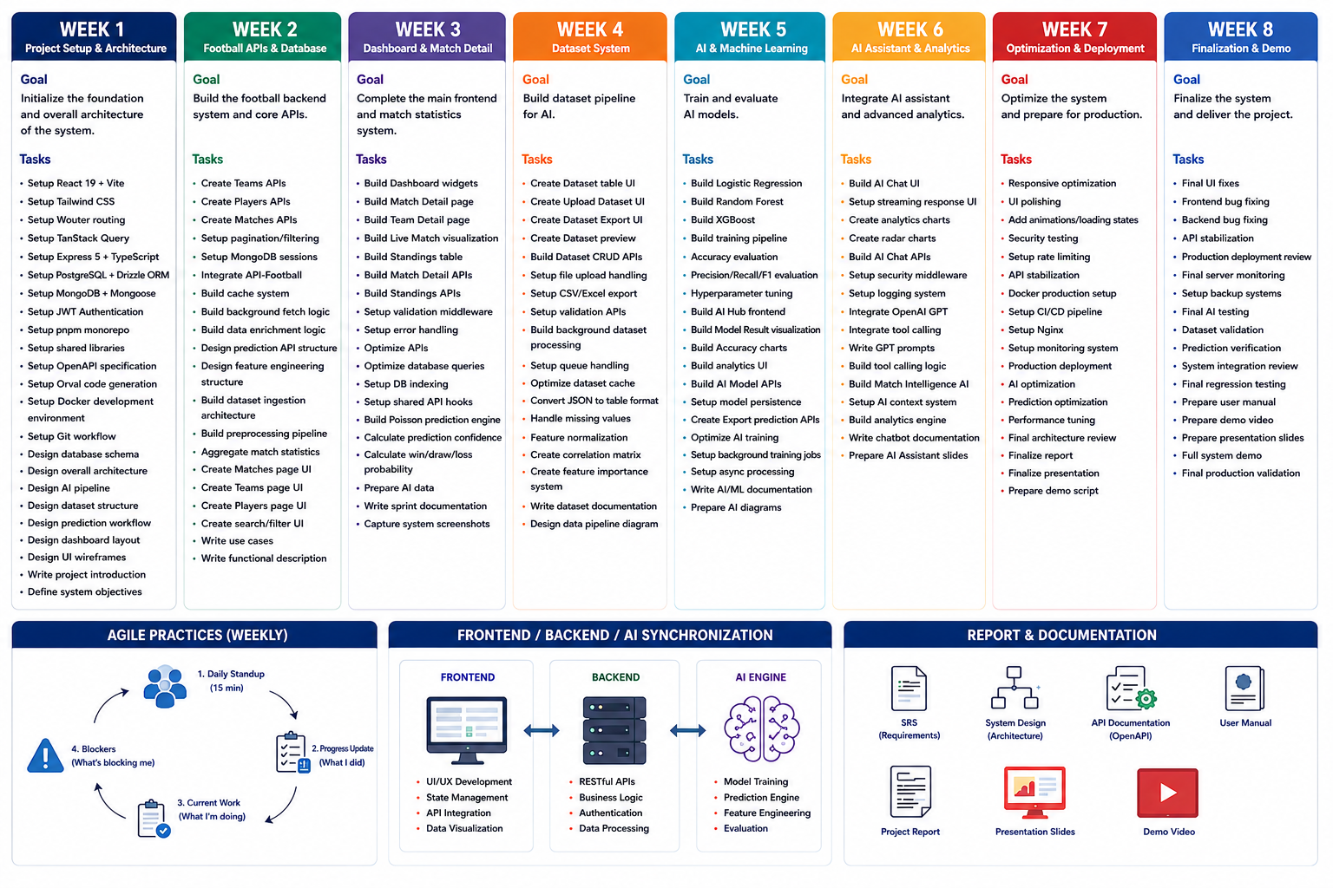
Work Breakdown Structure (WBS): Week 1 - Week 8
TEAM

Slide 15


Thank You!

